Slide 1
  Nonlinear meta-analysis
  Some examples and initial exploration of principles
David Rindskopf
CUNY Graduate Center
drindskopf@gc.cuny.edu
June 2025

Slide 2
Introduction
Meta-regression models are typically linear
Nonlinear models are sometimes plausible or necessary
Nonlinear=not a single straight line (as in James, Hastie, Tibshirani, Witten; JHTW: ISLR), not "nonlinear in the parameters"
I will discuss JHTW models + "truly nonlinear models"
  E.g. exponential decay, logistic, growth models

Slide 3
  Topics
Taxonomy of nonlinear models (including linear in the parameters, non-intrinsically nonlinear, intrinsically nonlinear)
Examples illustrating nonlinear meta-regression (Teacher expectancy, Reading, Wolfgang's data)
Principles of model selection (Number of studies, number of parameters or equivalent, interpretability, scientific or logical plausibility)
Software/computation (for discussion; metafor for some, or jags etc. for Bayes)

Slide 4
Types of Models (JHTW + others)
(pictures to follow)
Polynomials
Piecewise constants (constant within ranges)
Piecewise polynomials (polynomial in each segment of X)
Splines (continuity at knots)
  Cubic splines
  Natural splines
  Smoothing splines (knot at each distinct X value; restriction on 2nd derivative)
Local regression
Really actually truly nonlinear models
  Mostly based on exponentials/logarithms, or ratios
  E.g. exponential decay, logistic curves

Slide 5
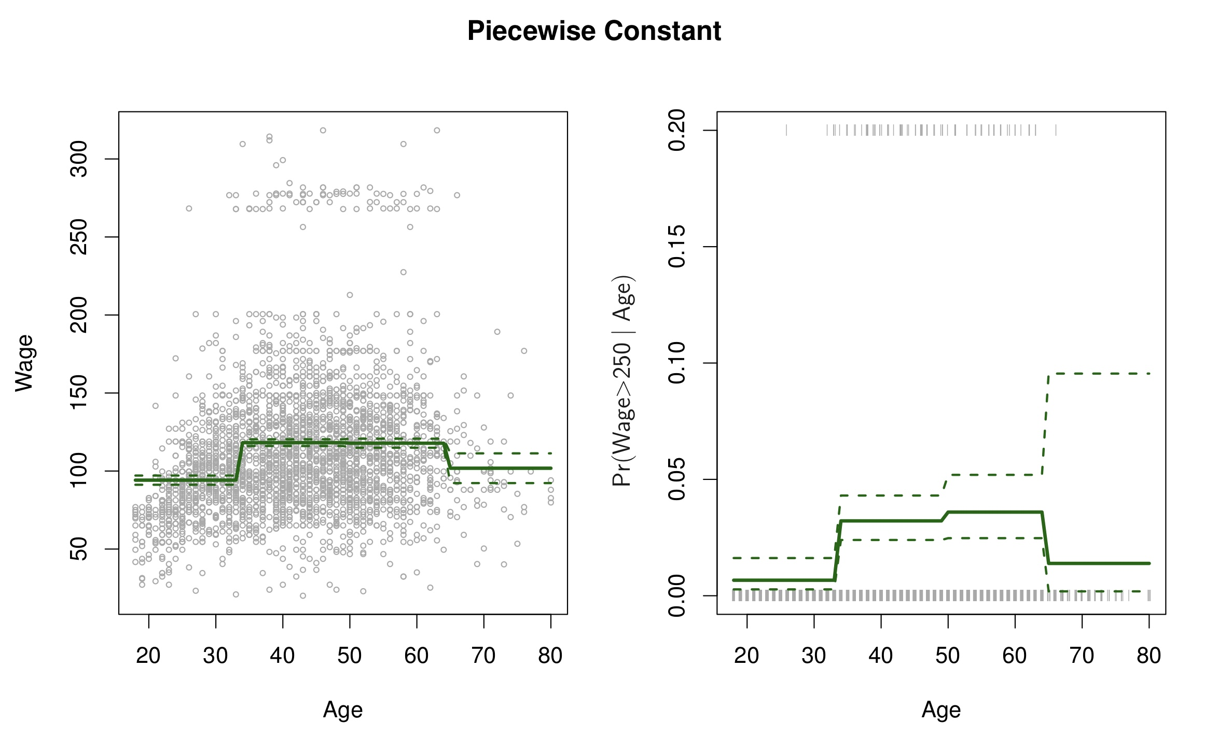

Slide 6
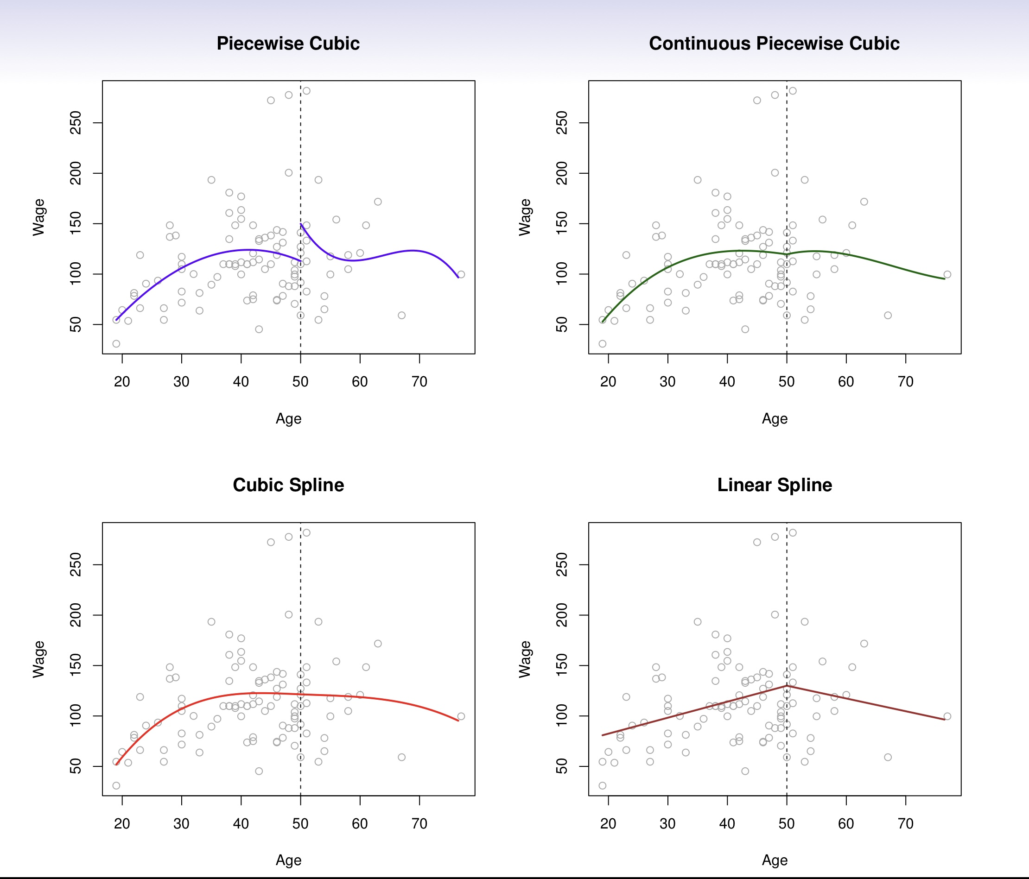

Slide 7
Considerations for models
Interpretable or not; with or without reparameterization (quadratic)
Goal: Description? Estimation? Prediction? Decision? Explanation?
Parsimony (related to k needed for analysis)
What sample size is needed to estimate the model well? And what does 'well' mean in this context?
Scientifically plausible?
Generative model or not?

Slide 8
Sample size considerations
Meta-analysis is different than most contexts for nonlinear models
Mostly small-k (number of studies)
In machine learning, large n is typical (hundreds, thousands, etc of data points)
Typical recommendations are for 10-20 data values per parameter
But this ignores the role of error variance (tau): Small tau --> fewer studies needed for precise estimation and model comparison
(For small k, precision of estimates depend also on the location of the X values in relation to places of large function changes)

Slide 9
Example 1: Raudenbush teacher expectancy data
Raudenbush, S. W., & Bryk, A. S. (1985). Empirical Bayes meta-analysis. Journal of Educational Statistics, 10(2), 75-98.
(one of?) the first meta-regression models
Teacher expectancy effect: teachers told certain students were going to "bloom"; IQ measured at end of year
R&B thought effect might be there, but would diminish if teachers were told after they already knew students
Model: ES ~ intercept + slope (weeks into school year)
Looks linear, but weeks is truncated at 3: 0, 1, 2, 3 or more

Slide 10
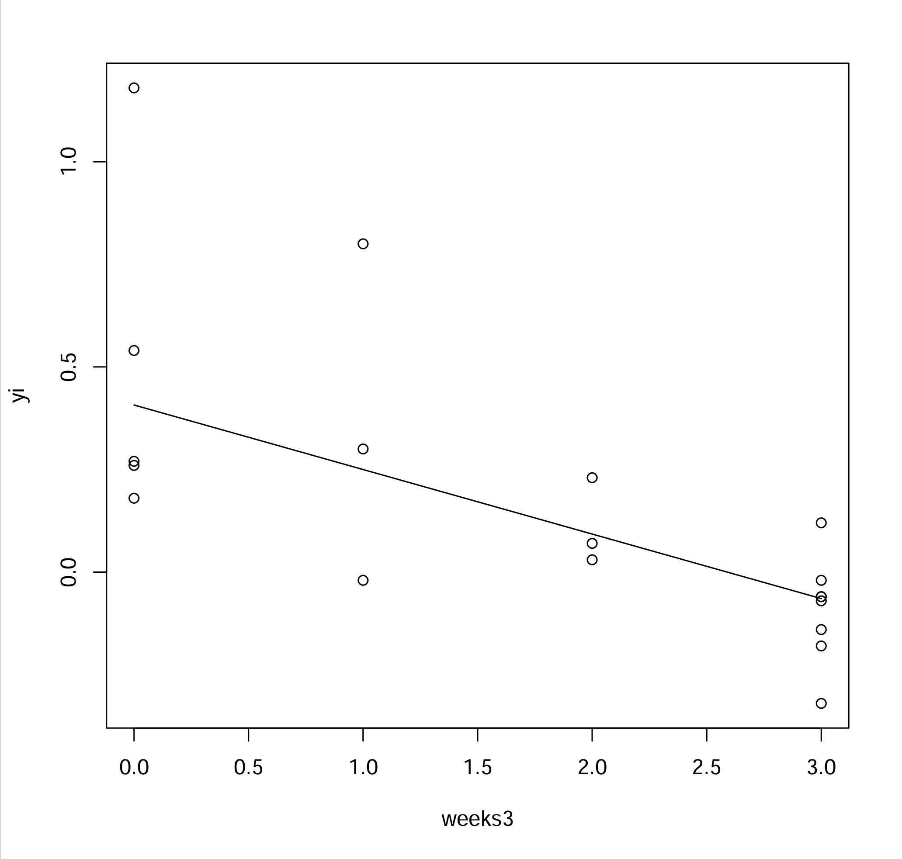
Apparently linear;
but is it?
And is it scientifically
plausible?

Slide 11
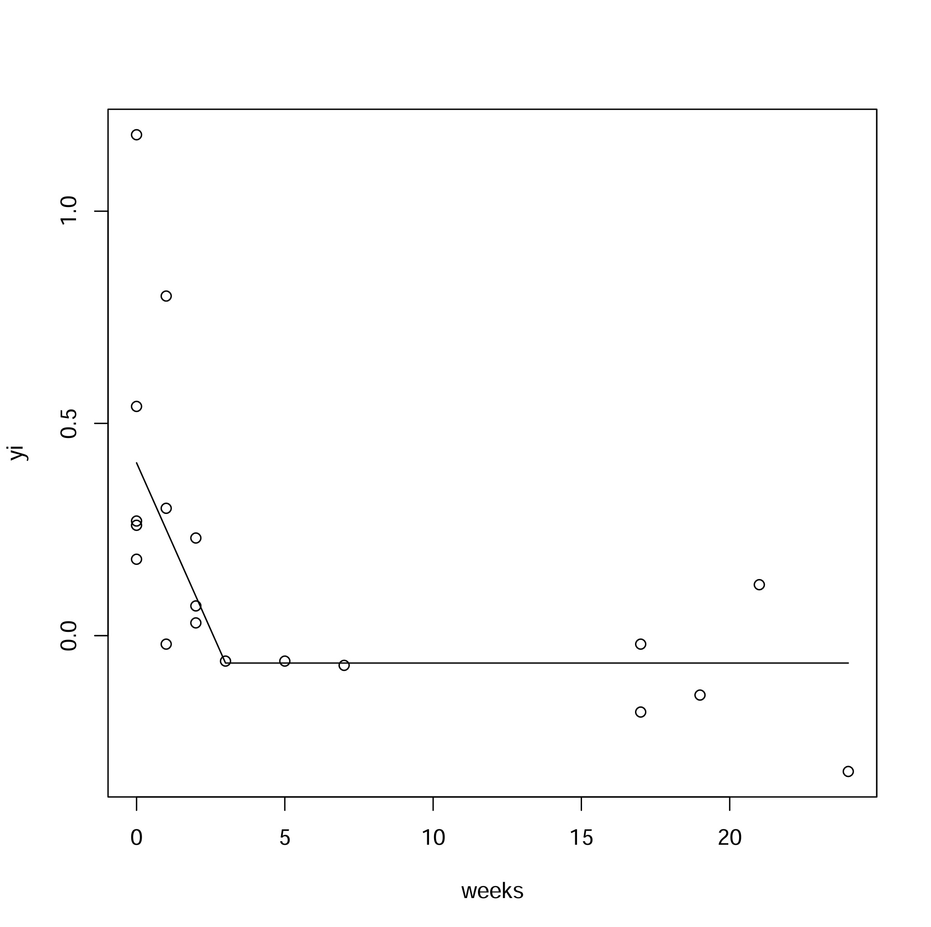
Simple, but not
scientifically plausible

Slide 12
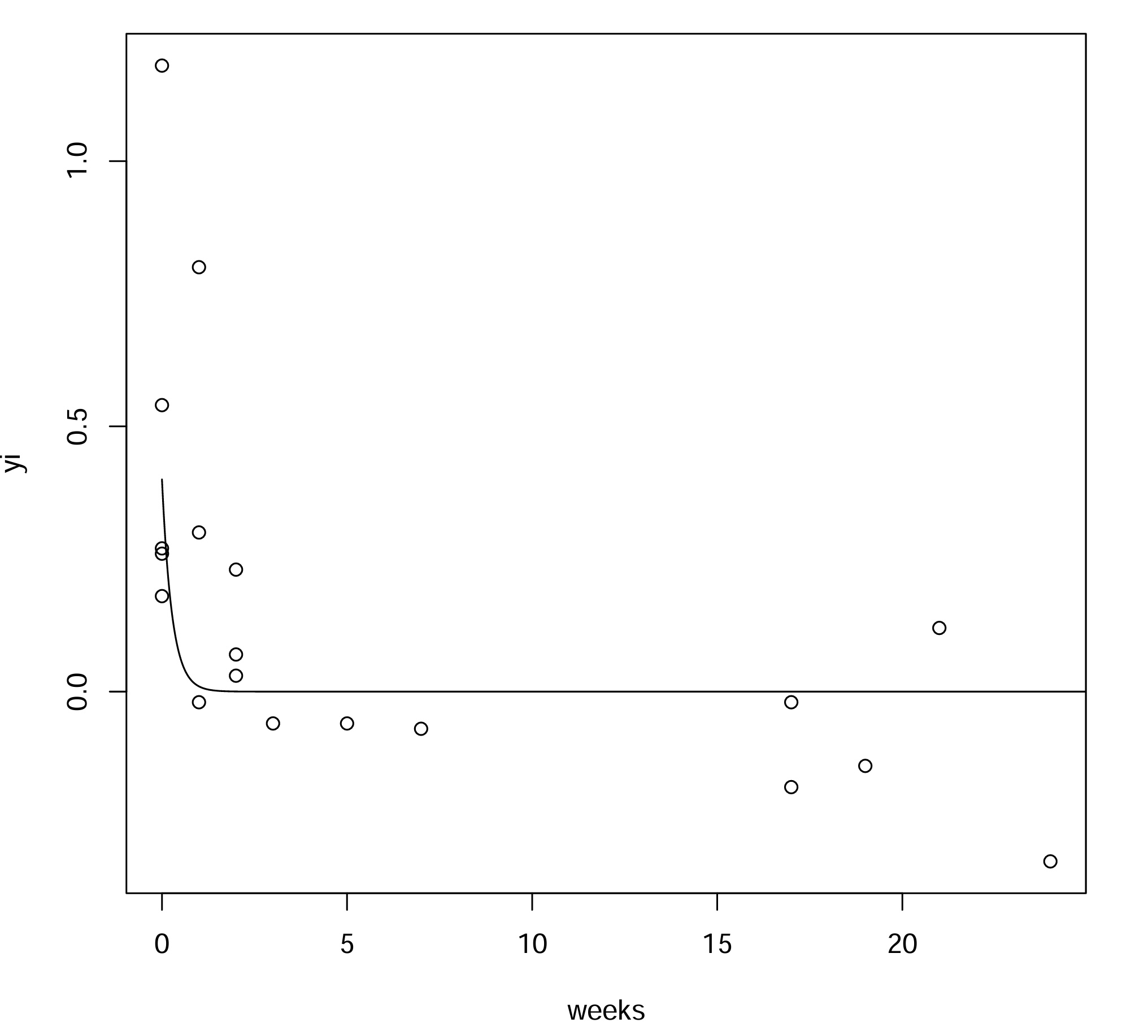
Exponential decay:
y = a exp(-b * weeks)
Scientifically plausible,
and simple

Slide 13
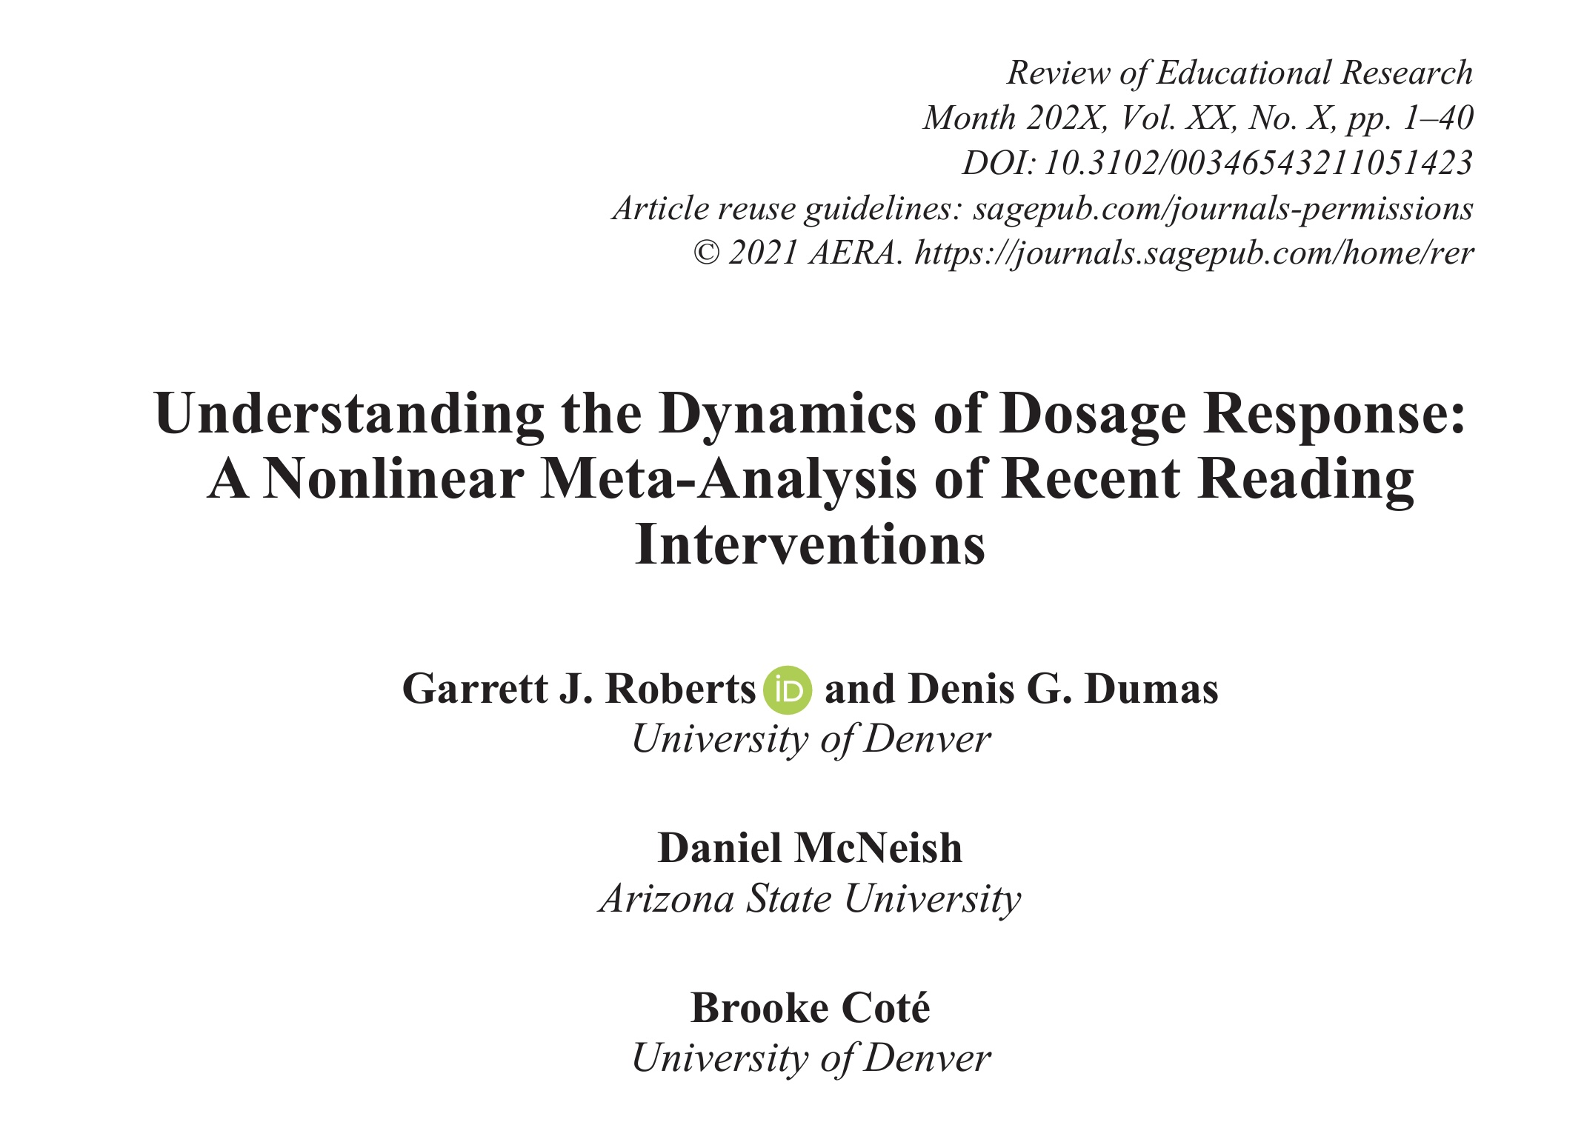

Slide 14
Usual quadratic representation
Parameters a and b are not usefully interpretable
c is (half) the curvature/2nd derivative
Other ways to write the model are better
$$Y=a+bX+cX^{2}$$

Slide 15
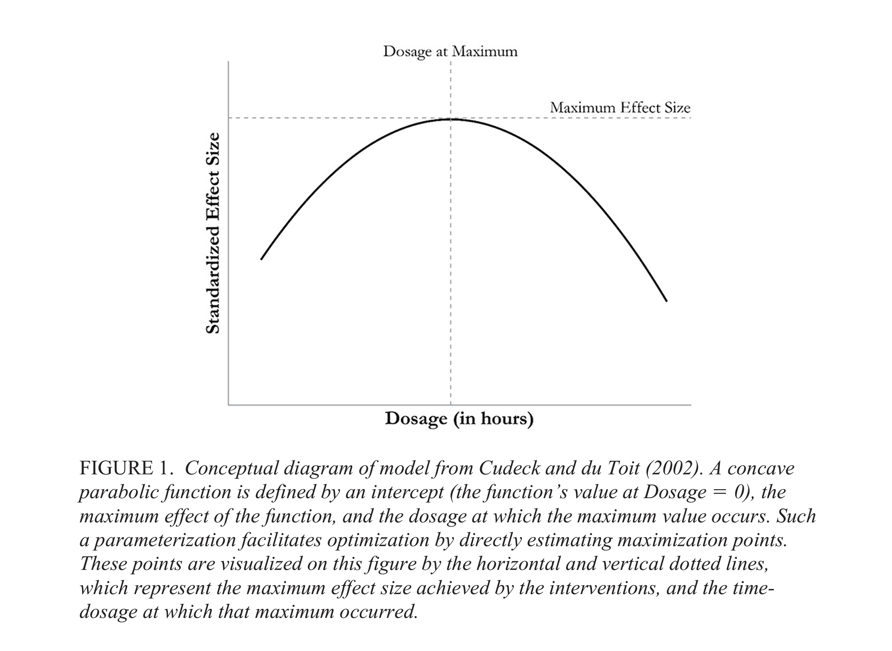
0

Slide 16
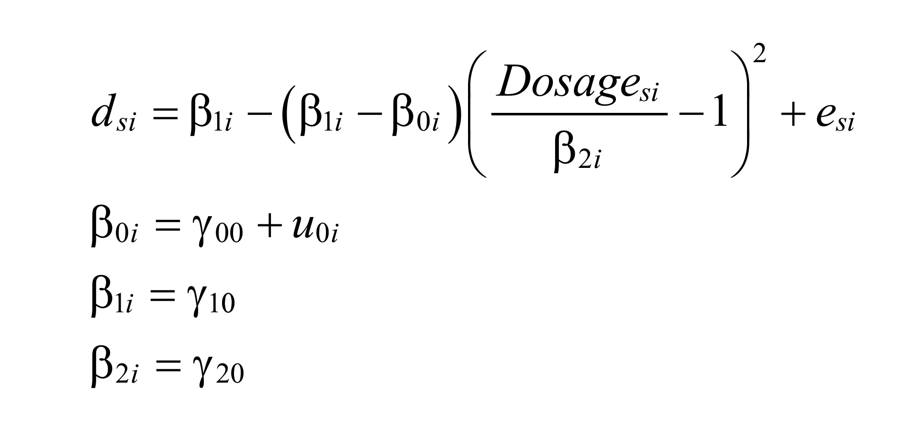

Slide 17
$$f\left(x\right)=a+c{\left(x-m\right)}^{2}$$
a max or min value of f(x)
m x value at which max/min occurs
c amount of curvature

Slide 18
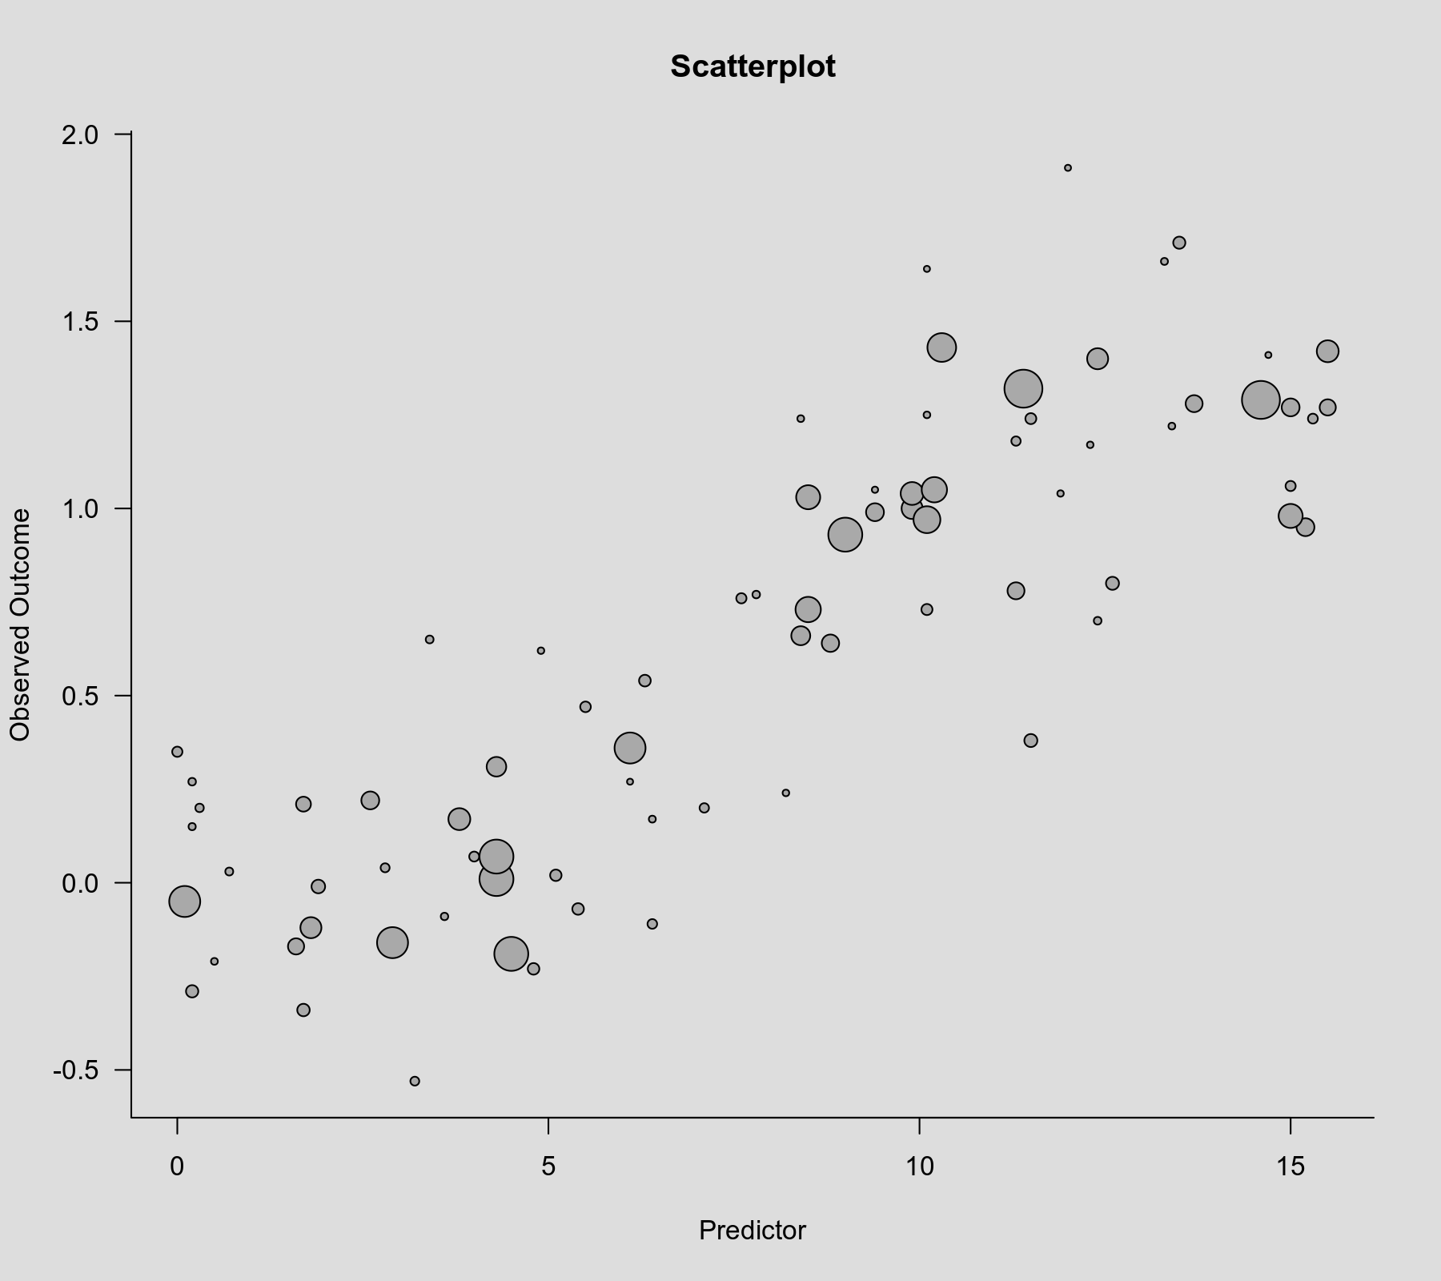
http://www.metafor-project.org/doku.php/tips:non_linear_meta_regression

Slide 19
Splines and their issues
How many knots? Where should they be?
Choose knots a priori? Or post hoc?
Degree of continuity?
Degree of polynomial?
Should we use splines (which are "linear" models), even though we can't interpret the parameters?
Or should we try parametric nonlinear models?
How about scientific plausibility of the model?

Slide 20
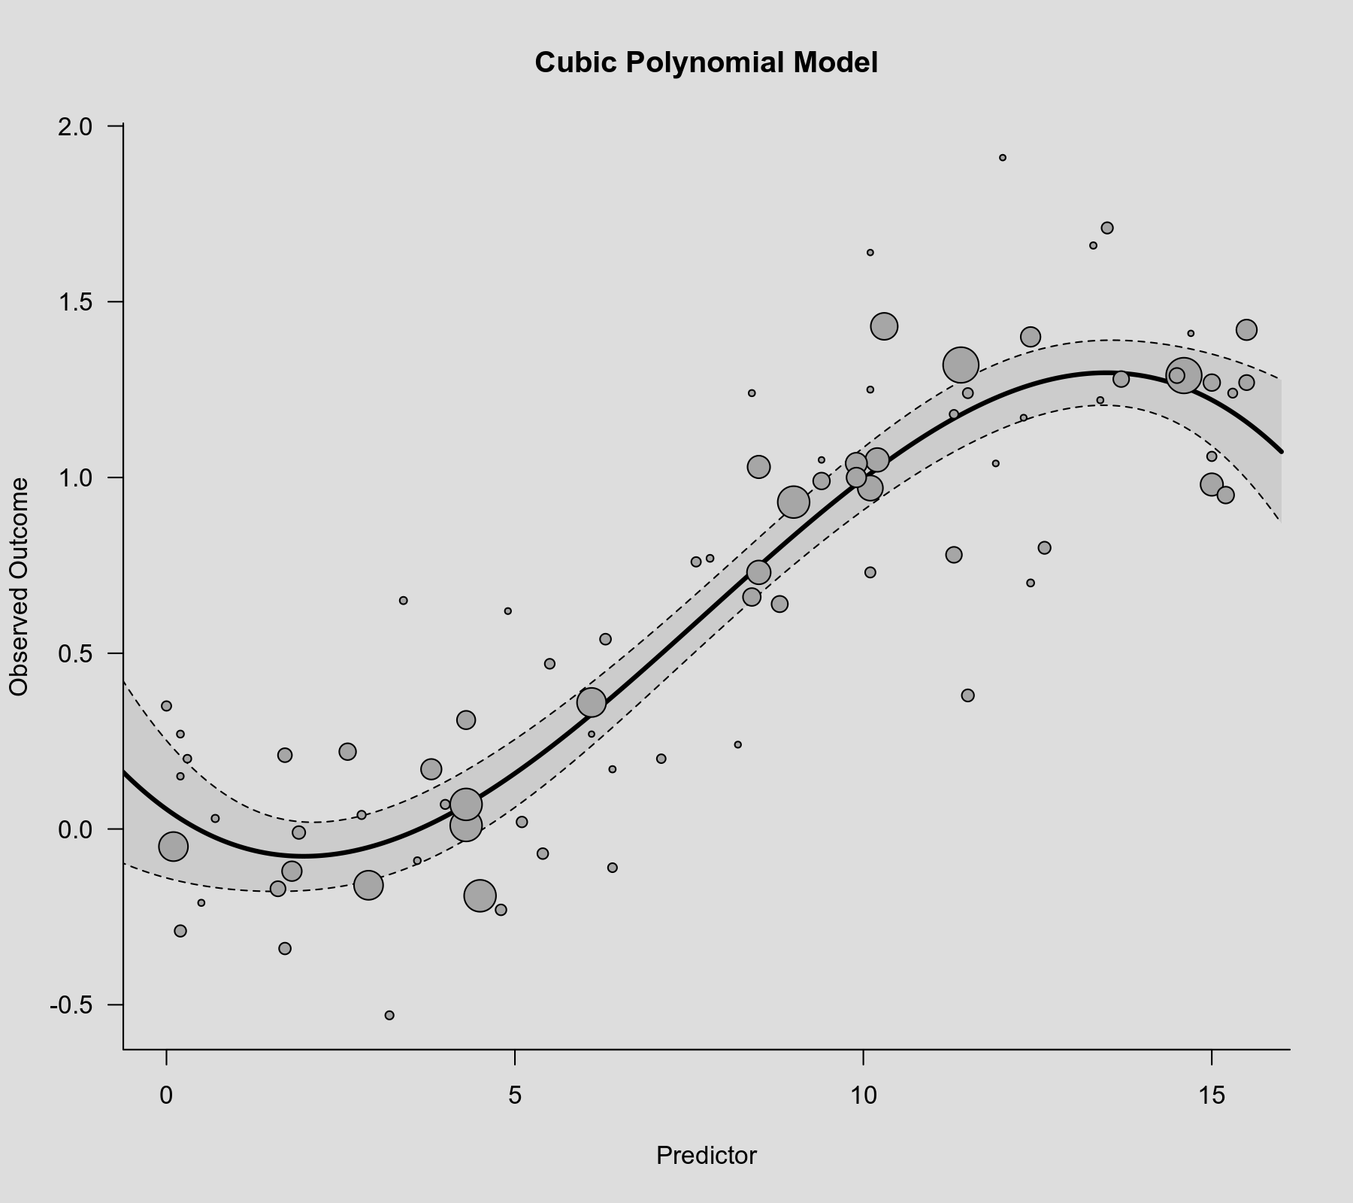

Slide 21
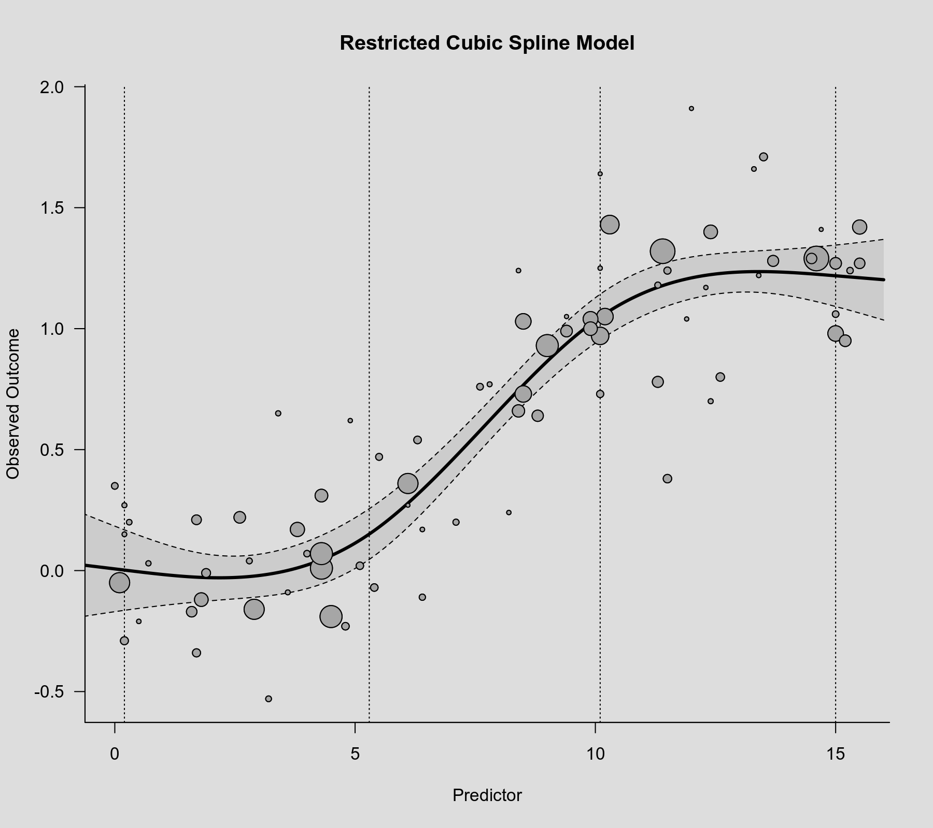

Slide 22
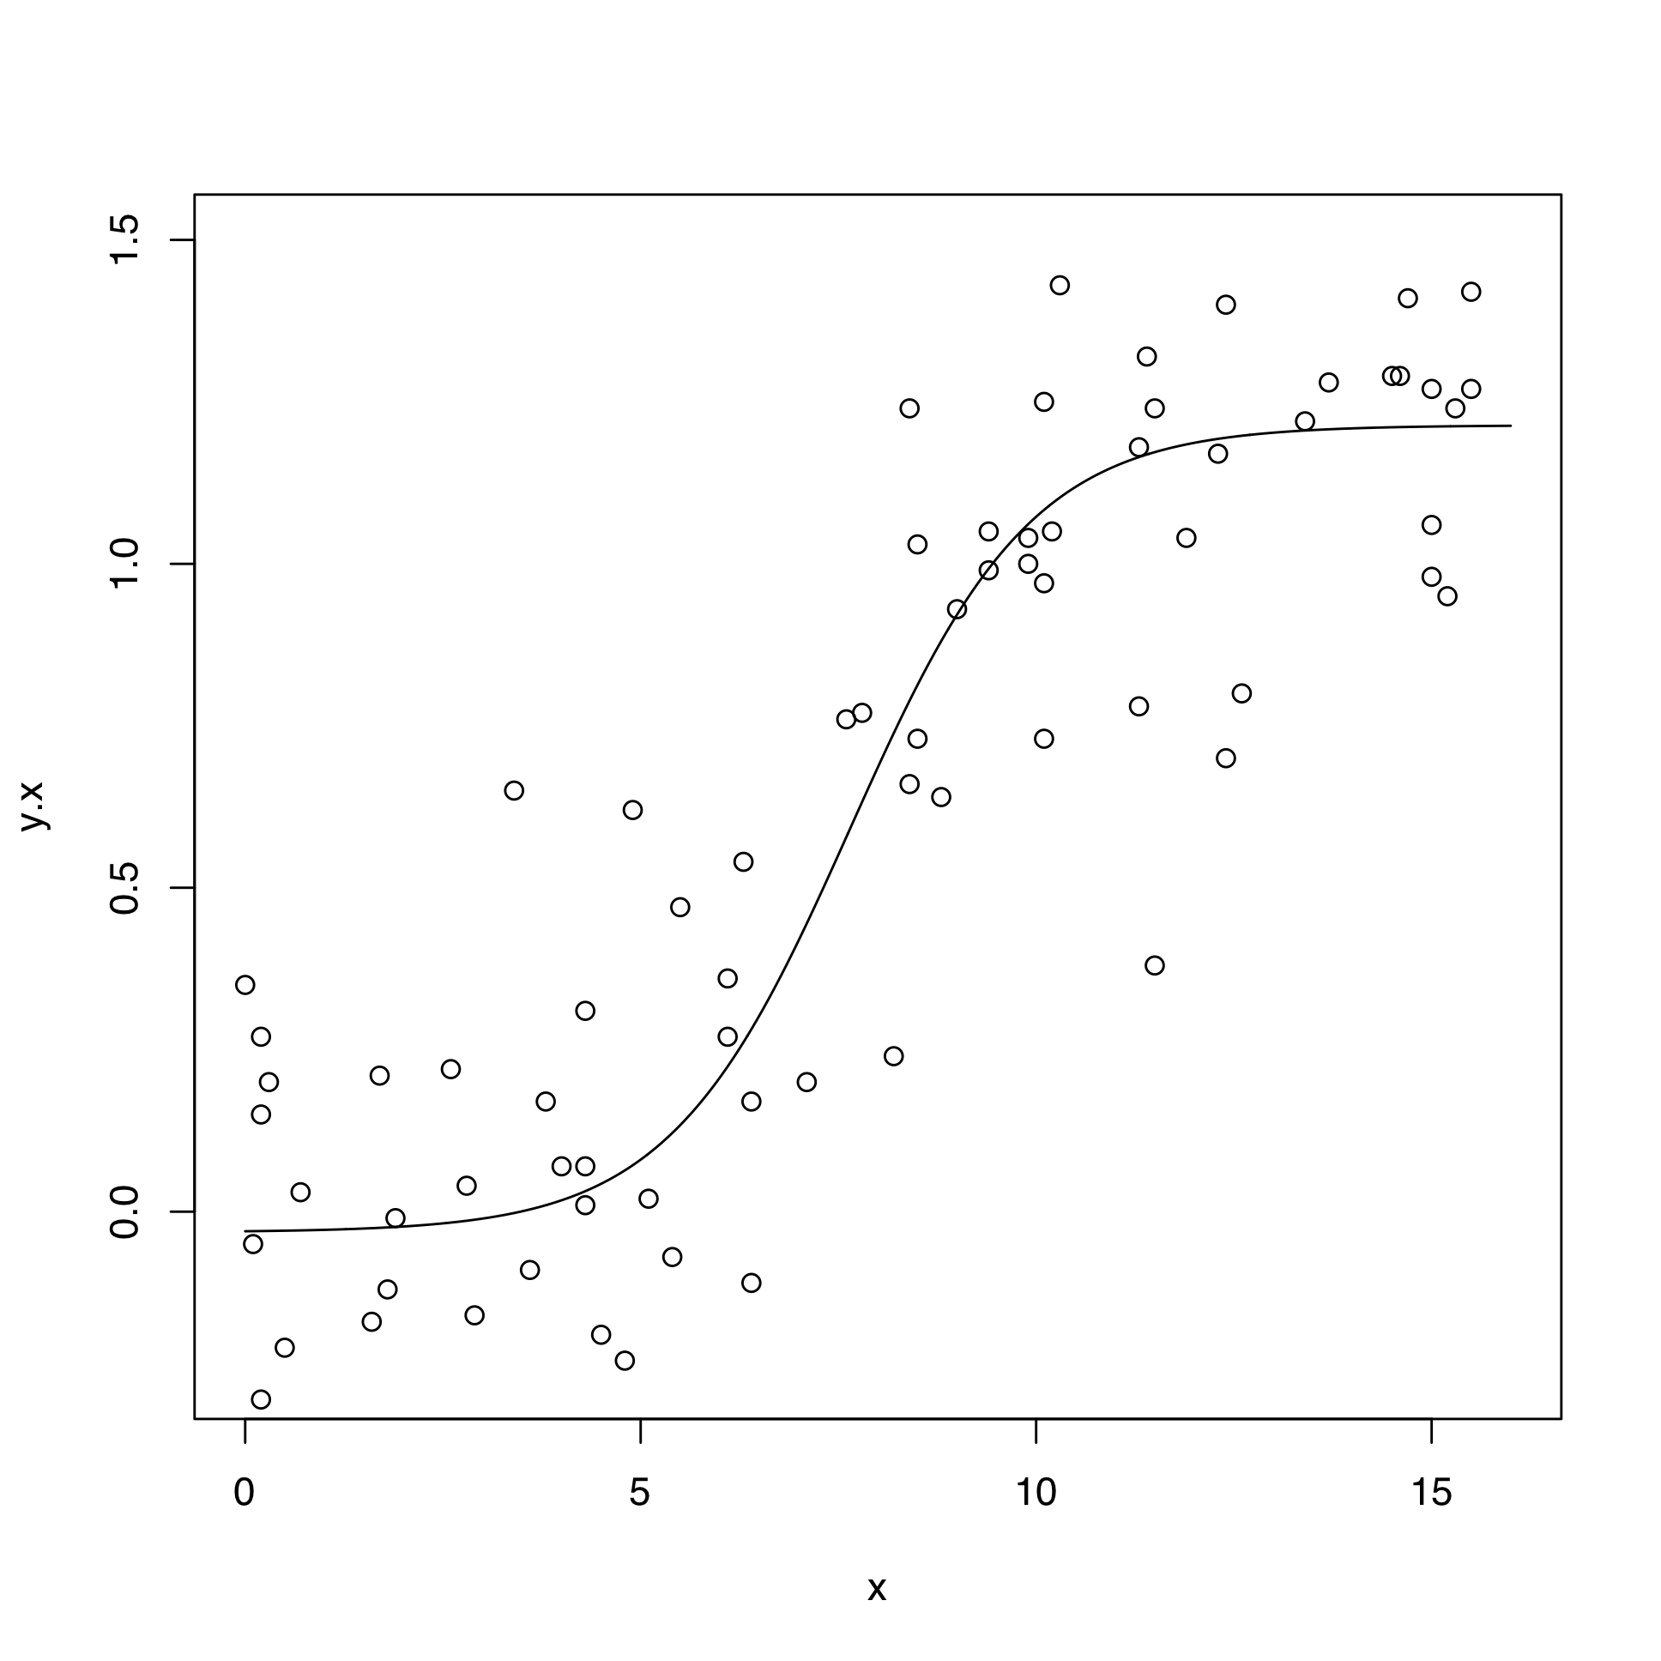
$$f+\left(c-f\right)\frac{exp\left(B\left(x-H\right)\right)}{1+exp\left(B\left(x-H\right)\right)}$$
f | floor (lower asymptote) | -0.03
c | ceiling (upper asymptote) | 1.21
B | slope | 0.87
H | x value of halfway rise | 7.65

Slide 23
Parametric model has some advantages,
if exploration or prediction is not the goal
All parameters interpretable (and meaningful)
Few parameters; not too complex a model for the amount of data
  Many meta-analyses are too small to support exploratory methods
Scientifically plausible (in many cases)

Slide 24
  Considerations in choosing a model
Purpose:
  Exploration? Description? Inference? Prediction? Explanation/Scientific plausibility?
Number of studies and apparent adherence to model (conditional heterogeneity), and relationship to:
Number of parameters (or equivalent in splines)

Slide 25
A mathematician's opinion on overparameterization:
"With four parameters I can fit an elephant, and with five I can make him wiggle his trunk." ~ John von Neumann

Slide 26
(From Harrell) R. A. Fisher (as quoted in Lehmann) had these suggestions about model building:
“(a) We must confine ourselves to those forms which we know how to handle,”
(b) “More or less elaborate forms will be suitable according to the volume of the data.”

Slide 27
Chatfield (1995; JRSSA quoted in Harrell)
“It is indeed strange that we often admit model uncertainty
by searching for a best model
but then ignore this uncertainty
by making inferences and predictions
as if certain that the best fitting model is actually true.”

