Slide 1
Registry-based non-randomized studies in benefit assessments
NANA-Symposium 26.05.2026
Volker Vervölgyi
Drug Assessment Department

Slide 2
Background: marketing authorization, market access, health care
health care
Should the drug be used?
(added benefit/cost)
market access
Can the drug be prescribed in general?
(decision health care system)
market authorization
Can the drug be used in general?
(positive benefit-risk ratio)
development

Slide 3
Background: marketing authorization, market access, health care
benefit assessment
health care
Should the drug be used?
(added benefit/cost)
market access
Can the drug be prescribed in general?
(decision health care system)
market authorization
Can the drug be used in general?
(positive benefit-risk ratio)
development

Slide 4
Non-randomized studies on intervention effects – various forms
Same data source, parallel data collection
Prospective or retrospective, non-randomized, comparative study
Same data source, non-parallel data collection
non-randomized, comparative study, e.g., new therapy prospectively, previous standard therapy retrospectively
Different data sources
Non-randomized, comparative study across multiple data sources (e.g., registries)
Comparison of a single-arm approval study with external control from routine practice data (registries, prescription data)

Slide 5
Single-arm trial vs. 'historical' control –
Case example Nivolumab in colorectal cancer
Data on Nivolumab: single-arm interventional study CA209-142
Data on the comparator therapy: routine data from the USA (Flatiron registry)
Inclusion criterion Nivolumab study, among others: Side effects of the previous therapy had to have completely subsided
Criterion not recorded in routine data and therefore not representable
➔ Visible due to different time periods between therapy changes: < 3 months in 100% of the comparison group, only in 50% under Nivolumab (directly vs. delayed after progression)
This results in (at least) the following problem:
  Violation of positivity (only in the Nivolumab arm exclusively patients without side effects from previous therapy)

Slide 6
Examples: comparative analyses of registry data for benefit assessments
Nusinersen in spinal muscular atrophy (A20-114)
No planning of a registry study identifiable
Evaluation of existing data unsuitable (among other things, a significant amount of missing values, important confounders not collected, observation time in the comparison group significantly shorter)
Asfotase alfa in hypophosphatasia (A19-89)
No planning of a registry study identifiable
Analysis of existing data unsuitable (including no adequate consideration of confounders, incomplete documentation for comparison group, substantial amount of missing values)

Slide 7
Closing evidence gaps – the routine practice data collection (AbD)
§35a, 3b SGB V: "The Federal Joint Committee may…demand from the pharmaceutical company, within a reasonable period, the submission of routine practice data collection and analyses for the purpose of benefit assessment: …“
→ concerns: orphan drugs, conditional approvals, and approvals under exceptional circumstances
Limited to non-randomized studies
Authorization to provide the new medicinal product can be limited to the centers participating in the AbD
Benefit assessment following data collection, renewed price negotiation; under certain circumstances (e.g., no data collection carried out), price discounts are possible

Slide 8
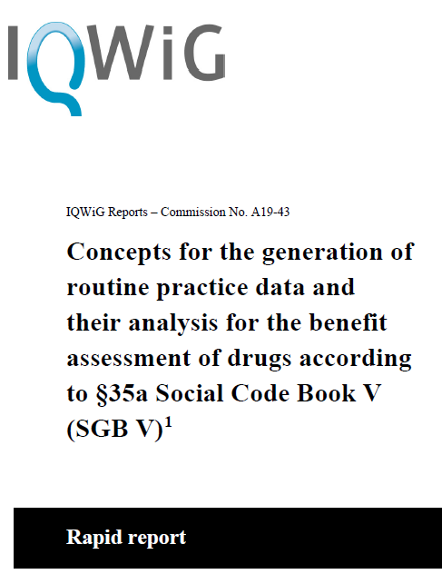
Requirements for data collection for AbD
Data collection for therapy of interest and current standard of care
No restriction to data collected as part of routine care per se
→ e. g. adding data on quality of life
Conclusions regarding health care in Germany
sufficiently valid and structured data
→ registries are potential data sources
IQWiG Rapid Report A19-43, Version 1.1, 13.5.2020. URL: https://www.iqwig.de/projekte/a19-43.html
Notes:
Konkrete Anforderungen an Datengenerierung sind in A19-43 beschrieben
Ergebnis des RR: neben einer studienindividuellen Datenerhebung kommen primär Register für den Zweck der NB infrage

Slide 9
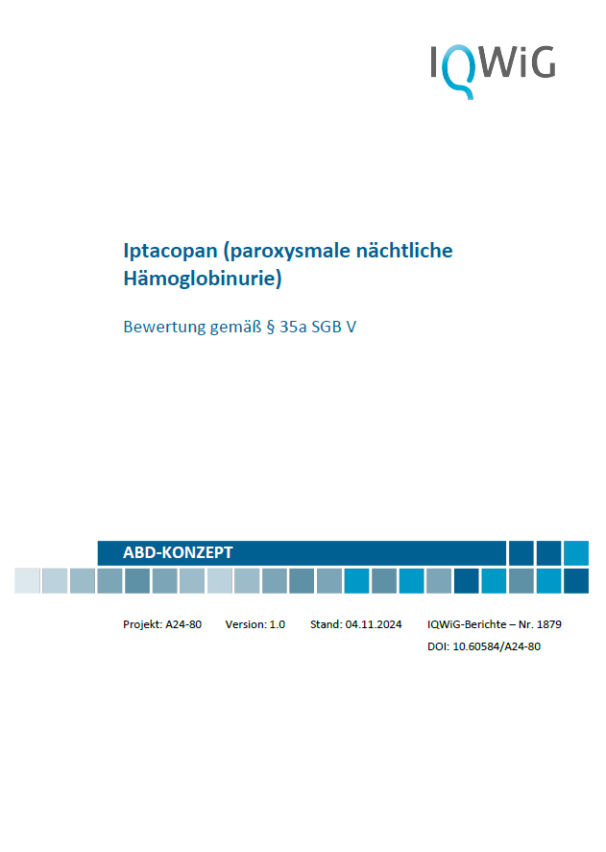
Contents of AbD Concept
Wording of the research question for the AbD
Research and assessment of ongoing, planned and completed data collections
  Is there (predictable) evidence to answer the research question?
Identification and assessment of registries as potential data source for the AbD
  Are there any registries? Are they appropriate or are adjustements required?
Duration and extent of the AbD
  How long should the AbD last? (recruitment + data collection)?
  How many patients need to be included?
  Is the AbD realistically feasible?
Notes:
Konkrete Anforderungen an Datengenerierung sind in A19-43 beschrieben
Ergebnis des RR: neben einer studienindividuellen Datenerhebung kommen primär Register für den Zweck der NB infrage

Slide 10
Previous experience in the development of concepts
Existing indication-specific registries generally suitable as primary data source for AbD!:
  Comprehensive documents (protocol, data plan), some publicly available
  Extensive data sets, some with precise definitions / dates
  Training on data collection, plausibility checks, to a certain extent SDV
  Patient population of interest for benefit assessment can largely be defined
Requirements for adjustment (across registries):
  Consistent reporting and data collection at sufficient frequency
  (standardized) collection of adverse events & patient-reported outcomes
  Collection of systematically identified confounders
  ➔ Study based solely on retrospective data not possible

Slide 11
Strong preference for the new drug — will there be enough patients to recruit for the control arm after approval?
In Germany, new drugs are eligible for reimbursement immediately upon market access
→ Is it possible to recruit enough patients for the control arm in a prospective data collection? (e. g.: Brexucabtagene autoleucel in mantle cell lymphoma)
It might be necessary to involve centres outside of Germany
→ Consider the transferability to the German health care context!
Initiation of procedure
Mandating of AbD
Review of protocol/SAP
recruitment
Market authorization
Market access
Start of AbD
Renewed benefit assessment
New drug is becoming established in clinical practice
Notes:
Bsp Brexu (MCL): primäre Datenquelle stellt das EMCL-Register dar, was von vorherein nicht nur deutsche sondern auch europäische Zentren beinhaltet hat.

Slide 12
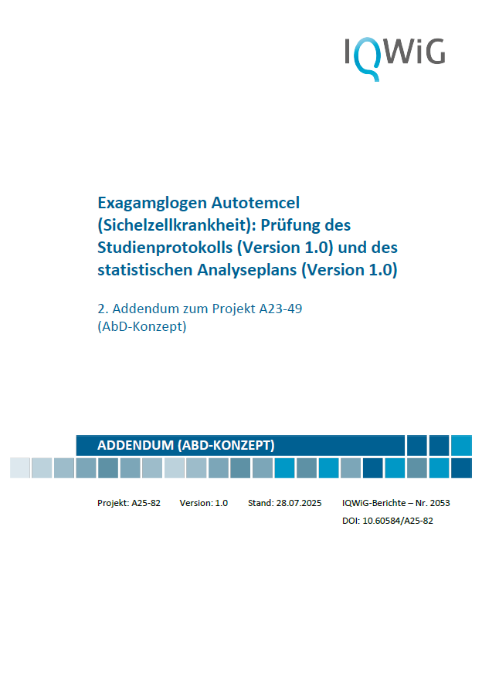
Contents of the study document review (protocol and SAP)
Positivity?
Assignment to treatment arms?
Start of observation?
Identification of confounders?
P-atients
I-ntervention
C-omparator
O-utcome
+ Confounders
patient-reported outcomes (PROs)?
Adjustment for confounders?
Inclusion criteria?
Estimand?

Slide 13
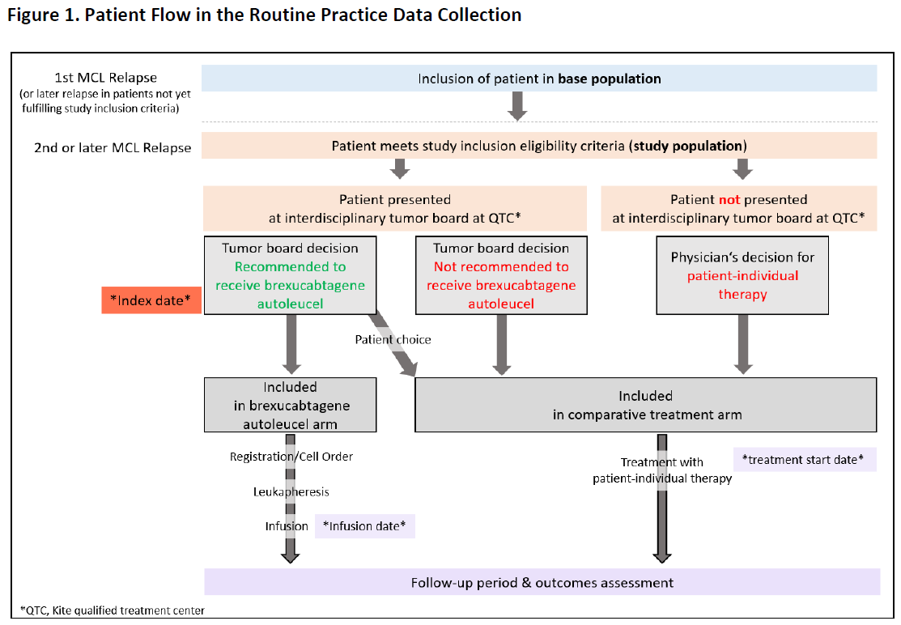
Assessment of positivity
Positivity: in theory, both therapies of interest are eligible for the patients
→ patient groups defined by research question
→ no contraindication to any of the therapies
Review based on inclusion and exclusion criteria

Slide 14
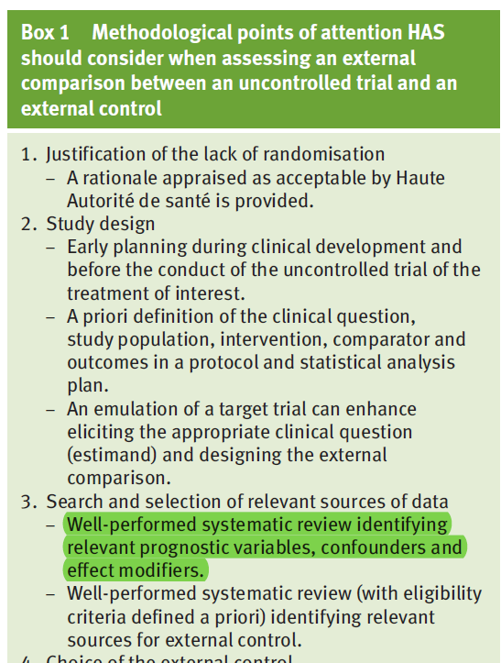
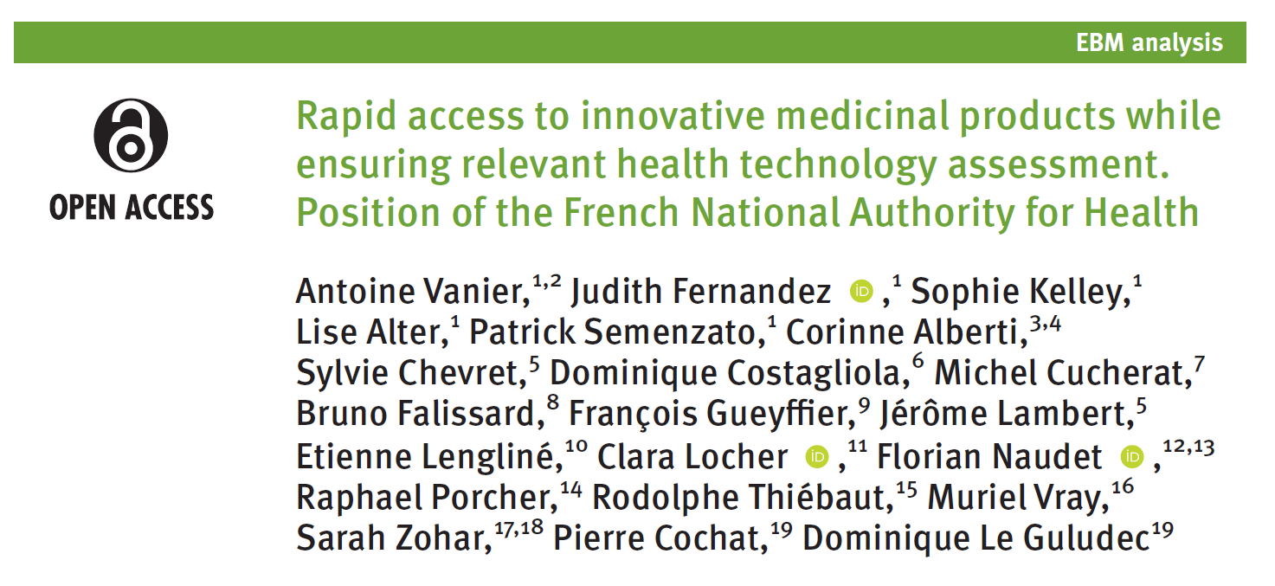
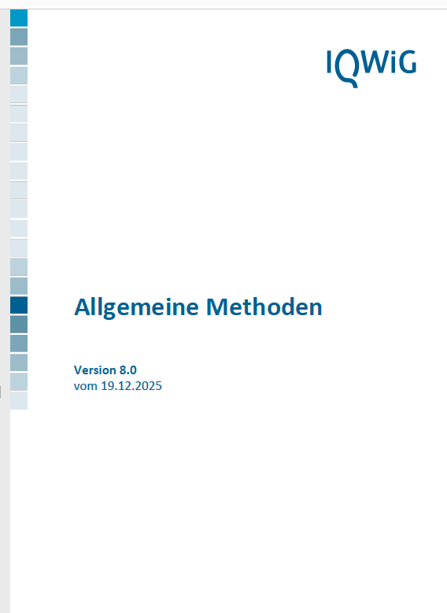
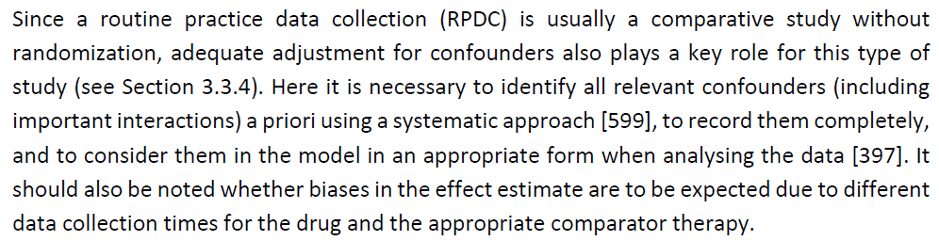

Systematic identification and collection of confounders
Vanier A, Fernandez J, Kelley S, et al. BMJ Evidence-Based Medicine 2024;29:1–5.
IQWiG 2023. Allgemeine Methoden 7.0

Slide 15
Systematic identification and collection of confounders
AbD in accordance with legal requirements as indication-specific data collection without randomization!
→ Replication of randomization, including comprehensive adjustment for baseline characteristics (not just adjustment for confounders currently being collected)
→ systematic identification of relevant confounders
→ collection and adjustment for relevant confounders in the analysis
P-atients
I-ntervention
C-omparator
O-utcome
+ Confounders

Slide 16
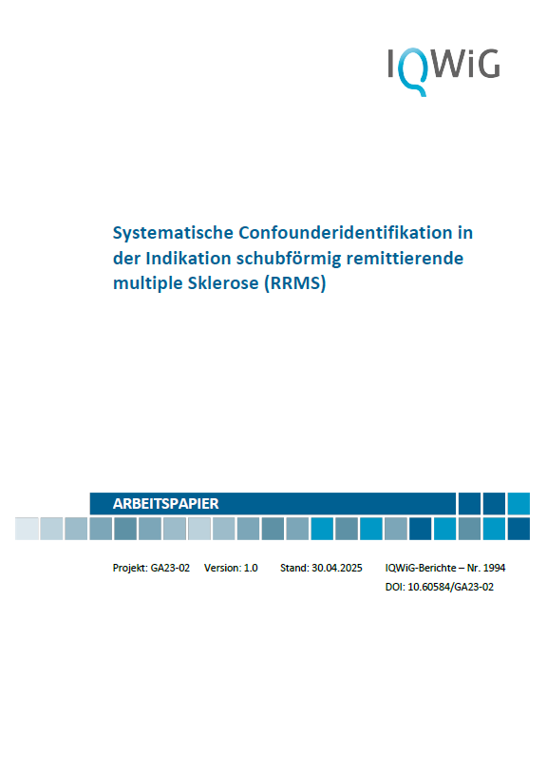
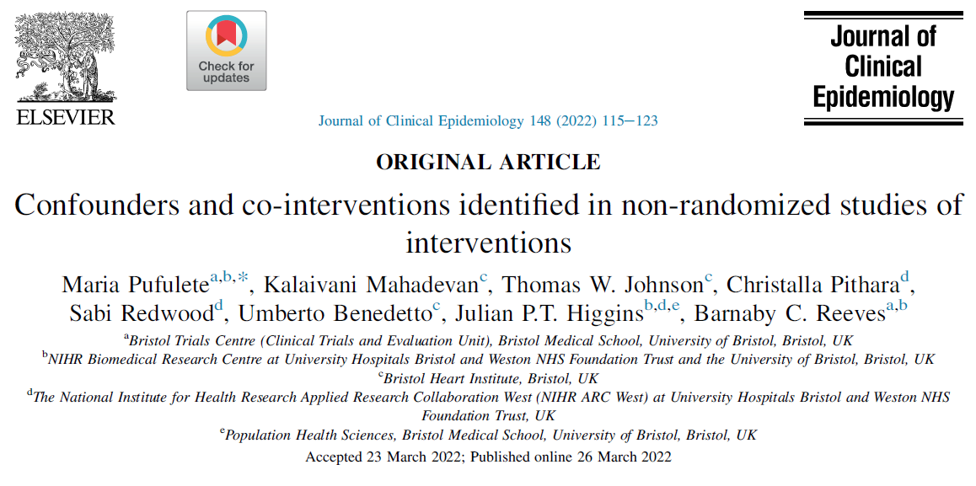
Systematic identification and collection of confounders
Only published proposal to date for systematic confounder identification
3-step approach
  Systematic literature review (search for observational studies and RCTs)
  Structured interviews with clinicians
  Survey among clinicians (listing of the 5 most important confounders)
Implementation in the study protocols of previous AbDs:
  Search often limited to secondary literature (systematic reviews)
  Identified factors excluded without adequate justification, examples:
    „Factor is part of inclusion criteria“
    „Considered as subgroup characteristics“
Pufulete M et al. J Clin Epidemiol 2022 https://doi.org/10.1016/j.jclinepi.2022.03.018
IQWiG 2025. URL: https://doi.org/10.60584/GA23-02

Slide 17
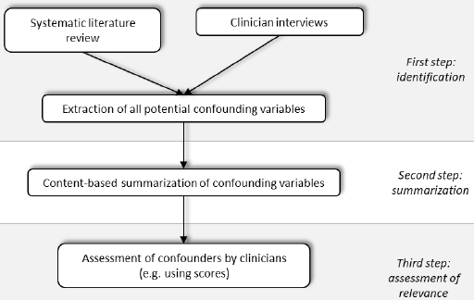
Extended proposal for a systematic approach to identifying confounders
Further development compared to the methodology described in Pufulete 2022: 2. step involves summarizing any confounding variables that overlap in content in order to save resources
Detailed and transparent documentation of the approach and results is required
In the working paper: recommendation of a checklist
Evaluation of further resource-saving options in a subsequent working paper

Slide 18
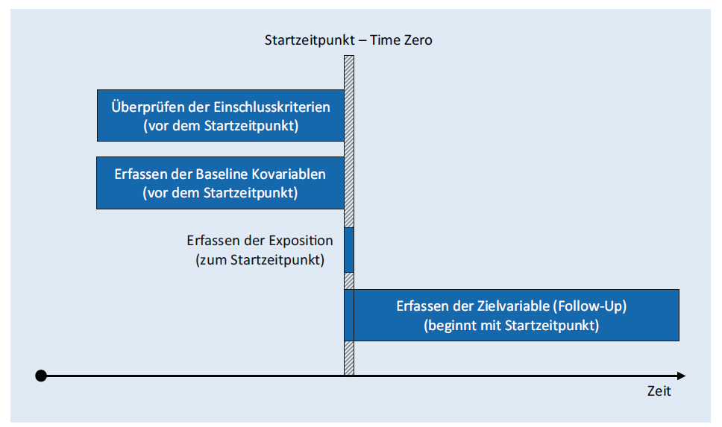
Selecting the start of the observation
Observation start: Index date (T₀)
Simple case:
There is an indication for switching, and patients may switch to either the treatment group or the control group
Ideal: Time of therapy decision (e. g. tumor board decision) as start of observation in both groups
Otherwise: most accurate möglichst genaue approximation of that time point
aus Braitmaier 2022; https://doi.org/10.1007/s11553-022-00967-9

Slide 19
Selecting the start of the observation
Complicated case:
Patients in the control group do not start any other treatment, but continue to receive standard of care!
Problem: Adequate determination of the start of observation for patients in the control arm
→ It is essential that observation begins at the same time for patients in both arms; otherwise, there is a risk of bias (e.g. immortal time bias)
Various methods to estimate T₀
aus Braitmaier 2022; https://doi.org/10.1007/s11553-022-00967-9

Slide 20
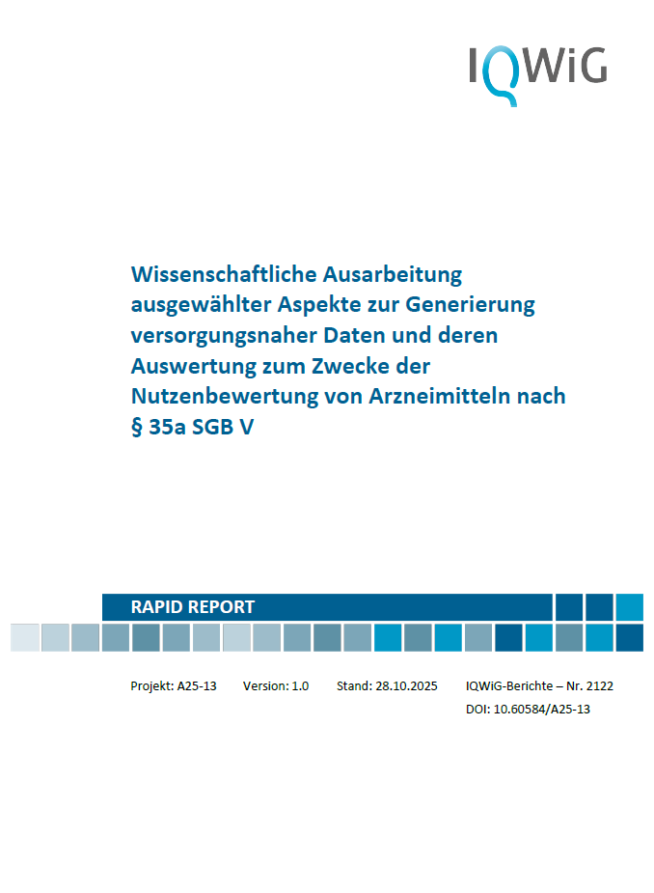
(PRO) collection in registries
In case of ATMPs different treatment approaches are usually compared (e. g. CAR-T-cell vs. chemotherapy, single-dose gene therapy vs. continuous therapy)
Collecting data solely during clinic visits may result in variations in the frequency and intervals of data collection
  Difficulties in interpreting the results
  → Collecting data solely in the registry may not be practical
Possible solutions:
  Collection outside the registry → use of digital solutions to facilitate data collection for patients
  → Use of the information for patient care
IQWiG Rapid Report A25-13 vom 28.10.2025.
URL: https://www.iqwig.de/projekte/a25-13.html

Slide 21
Adjustment for confounders
In previous study protocols / SAPs, the adjustment is primarily planned using propensity scores
  Propensity score: Probability that the patient will receive the trial intervention
  Weighting methods (IPTW, FSW, SMRW) or PS matching
clear hierarchy of eligible PS methods and criteria for selecting the most robust methods
Determining sufficient overlap and balance
Describe how to handle extreme values (truncation vs. “capping”)
Description of the population after PS matching or weighting

Slide 22
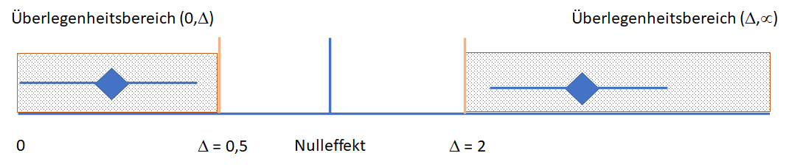
For valid conclusions, the expected effect must not be too small
Even with the most careful analysis and fulfilment of the mentioned quality requirements, there is an inherent risk of substantial bias due to the study design, e.g.:
  Discrepancies in the start of observation
  Unknown and non-measurable confounders
a conclusion on the benefit or harm of an intervention should only be derived from the effects observed in the study if these effects exceed a certain effect size
Test for a shifted null hypothesis, taking into account the actual data quality
Notes:
Auch bei sorgfältigster Analyse unter Erfüllung der genannten Qualitätsanforderungen sollte aufgrund potenziell unbekannter Confounder aus den in der Studie beobachteten Effekten erst ab einer bestimmten Effektstärke eine Aussage zum Nutzen oder Schaden einer Intervention abgeleitet werden.
Interpretation der Ergebnisse unter Berücksichtigung der möglichen Verzerrung aufgrund des nicht randomisierten Vergleichs; insbesondere Verwendung von Schwellenwerten für Konfidenzintervalle (Test auf verschobene Nullhypothese) unter Berücksichtigung der konkreten Datenqualität

Slide 23
Registry-based RCT as alternative option
According to legal requirements, AbDs must be conducted without randomization
This results in increased requirements regarding the extent of data collection (additional collection of relevant confounders + larger sample size to detect sufficiently large effects)
„The effort required for a routine practice comparative study with randomization will generally – with comparable data quality – be less than the effort required for a study without randomization, as confounder data collection and confounder adjustment can be omitted.“
IQWiG Rapid Report A19-43, Version 1.1 vom 13.5.2020. URL: https://www.iqwig.de/projekte/a19-43.html
Notes:
Was ist die Lösung des Problems?
Alternative Option, die auf folgende Vorträge überleitet.
Wir bleiben bei Registern, aber kombinieren dies mit einer Randomisierung: rRCT

Slide 24





Institute for Quality and Efficiency
in Health Care (IQWiG)
–
Siegburger Str. 237
50679 Köln
Phone: +49 221 35685-0
Fax: +49 221 35685-1
Email: info@iqwig.de
www.iqwig.de/en/
www.informedhealth.org
www.themencheck-medizin.de

Slide 25
Thank you for your attention!
–
Questions and comments:
[Name of speaker]
[Contact, e.g. employee email address]
Institute for Quality and Efficiency
in Health Care (IQWiG)
–
Siegburger Str. 237
50679 Köln
Phone: +49 221 35685-0
Fax: +49 221 35685-1
Email: info@iqwig.de
www.iqwig.de/en/
www.informedhealth.org
www.themencheck-medizin.de

